Slide 1
COMPILING
BHAVANA
DAY 10
16/04/2024

Slide 2
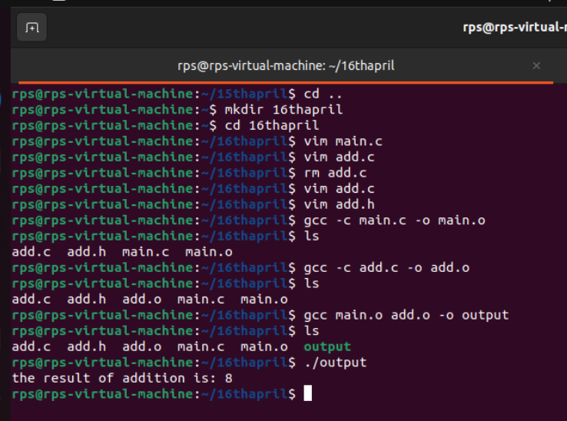
LINKING 2 FILES:

Slide 3
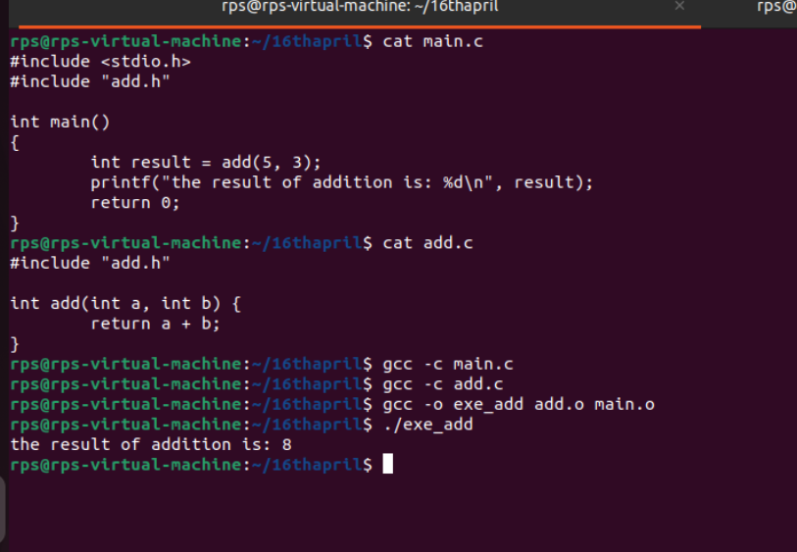

Slide 4
Stepping through the stages
● Pre-Processor ○ $ gcc -E [flags] [filenames]
● Compiler ○ $ gcc -S [flags] [filenames]
● Assembler ○ $ gcc -c [flags] [filenames] ○ $ objdump -d [filenames]
● Linker ○ $ gcc -o [exename] [flags] [filenames]
Common GCC Flags
-o [EXECUTABLE NAME] : names executable file
-Ox : Code optimization -O0 : Compile as fast as possible, don’t optimize [this is the default]
-O1, -O2, -O3: Optimize for reduced execution time [higher numbers are more optimized] -Os : Optimize for code size instead of execution time.
-Og : Optimize for execution time, but try to avoid making interactive debugging harder.
-g : produce “debug info”: annotate assembly so gdb can find variables and source code
-Wall : enable many “warning” messages that should be on by default, but aren’t - Does not turn on all of the warning messages GCC can produce.

Slide 5
Debugging a code in the terminal typically involves using a debugger like GDB (GNU Debugger).
Here's a basic overview of how you can debug a C program using GDB in the terminal:
*Compile with debugging symbols*: When compiling your code, include debugging symbols by adding the -g flag. For example: bash gcc -g my_program.c -o my_program
*Run GDB*: Start GDB and specify the executable you want to debug: bash gdb ./my_program
*Set breakpoints*: Set breakpoints at the lines of code where you want to pause execution and inspect variables. (gdb) break line_number
*Run the program*: Start executing your program with the run command: (gdb) run
*Inspect variables*: Once your program hits a breakpoint, you can inspect variables using the print command: (gdb) print variable_name
*Step through code*: Use next to execute the current line and move to the next line, or step to enter into function calls: (gdb) next
*Continue execution*: To resume execution until the next breakpoint, use the continue command: (gdb) continue
*Quit GDB*: When you're done debugging, quit GDB: (gdb) quit

Slide 6
What is a makefile?
● Automates the process of creating files (using a compiler)
● For example, create bomb from bomb.c, phases.c, and util.c
● Can also store recipes for automating development tasks
○ make format to reformat source fileS
out.o: src.c src.h
$@ # "out.o" (target)
$< # "src.c" (first prerequisite)
$^ # "src.c src.h" (all prerequisites)
%.o: %.c
$* # the 'stem' with which an implicit rule matches ("foo" in "foo.c")
also:
$+ # prerequisites (all, with duplication)
$? # prerequisites (new ones)
$| # prerequisites (order-only?)
$(@D) # target directory

Slide 7
